Slide 1



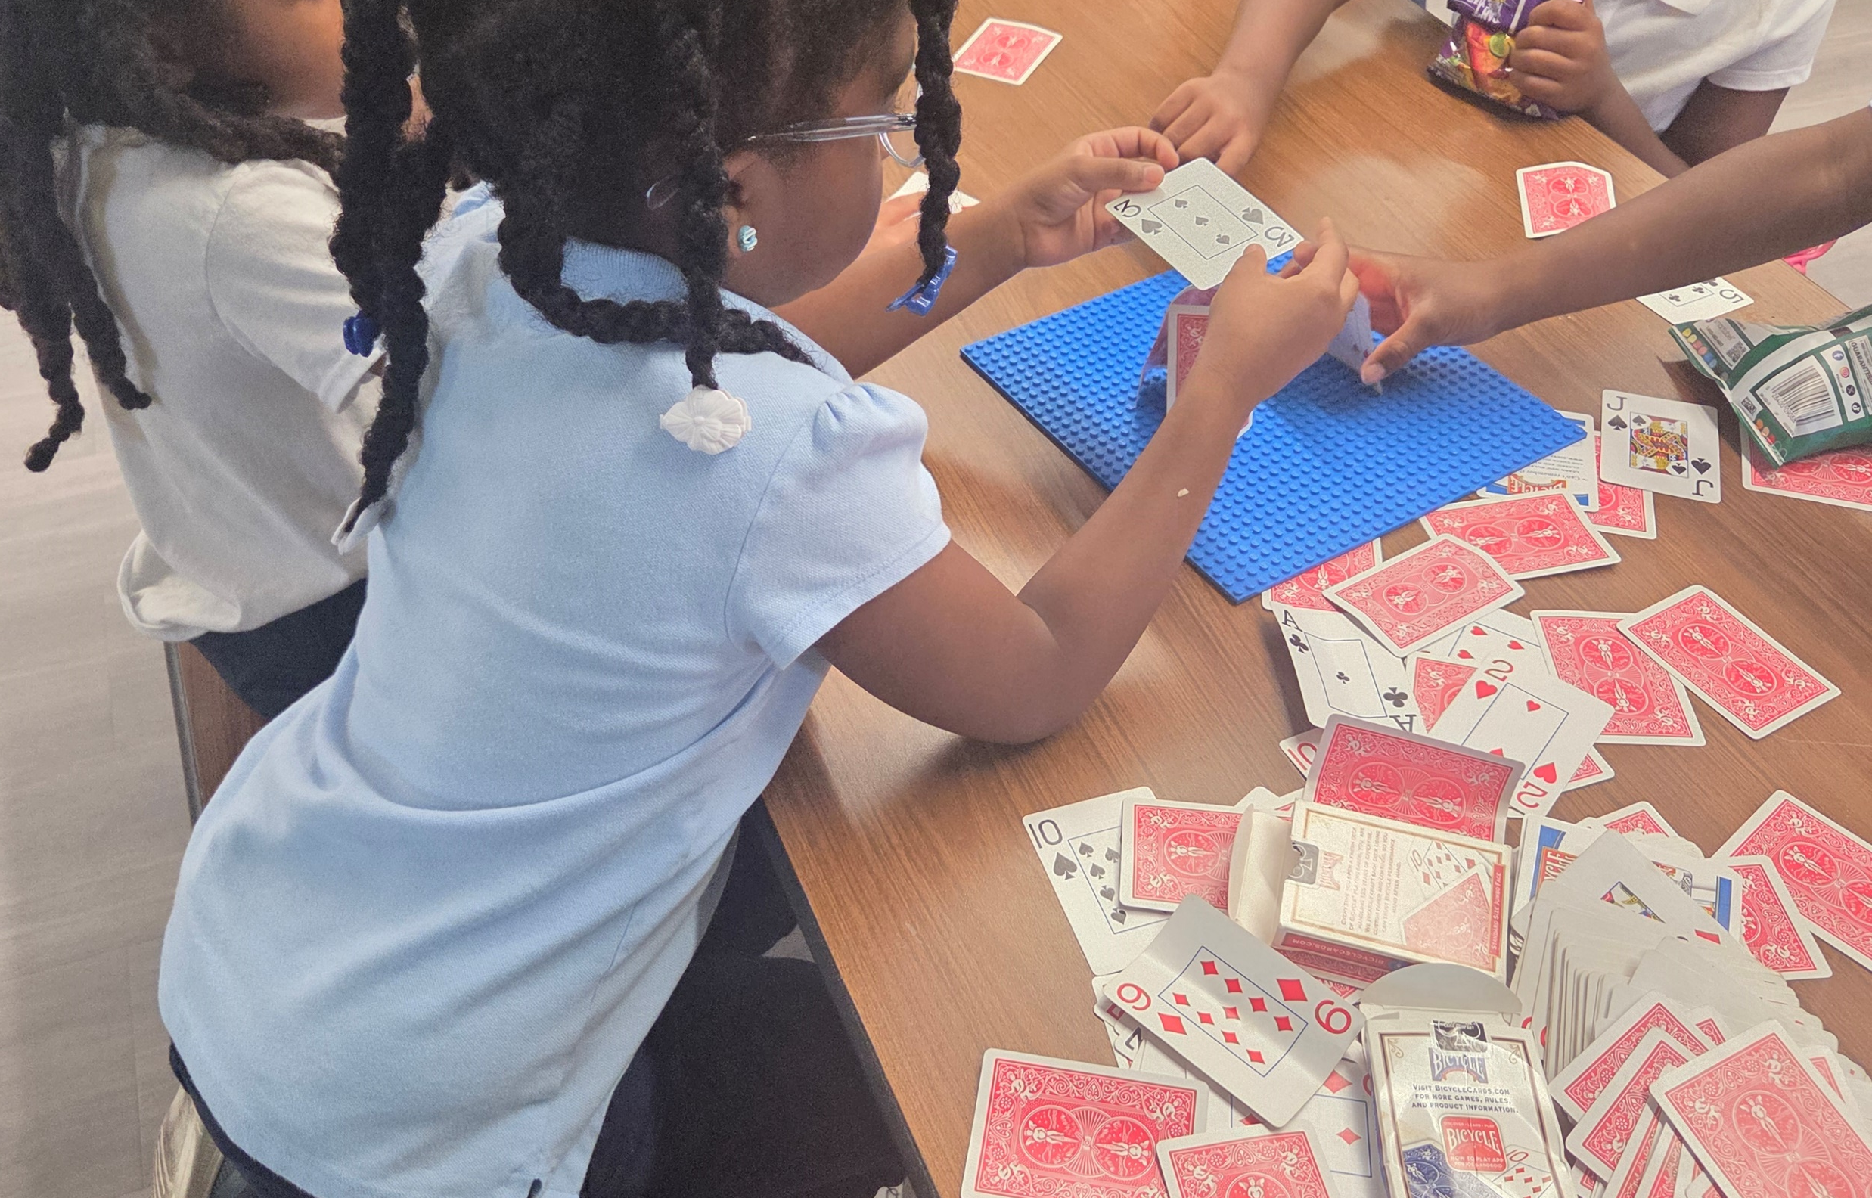
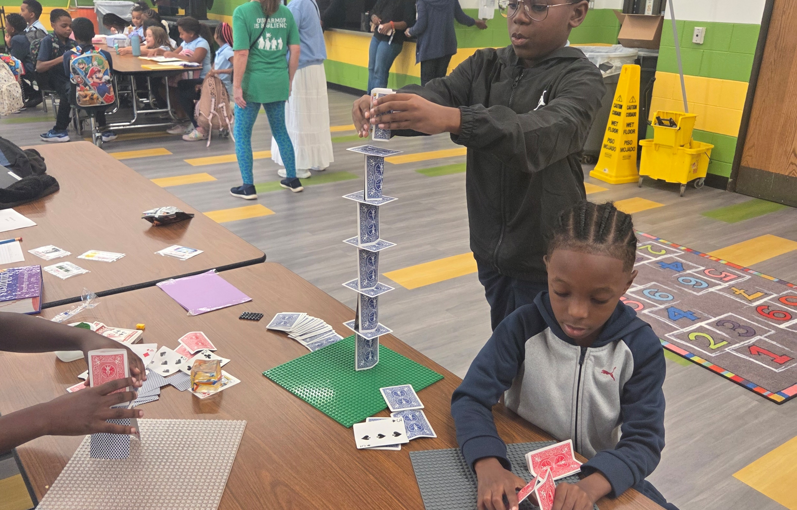
October brings a burst of energy to after-school care programs as the fall air cools and the countdown to Halloween begins. This month is a magical time for school-aged kids, shifting from the routine-setting of September into high-spirited creativity, hands-on science, and outdoor adventures before winter sets in.
Here is a breakdown on what makes October so vibrant for kids in Champions
Popsicle Stick Monsters: Creating miniature scarecrows, witches, and vampires using sticks, yarn, and googly eyes.
Mini Weather Stations: Tracking wind, rain, and dropping temperatures to learn about seasonal patterns.
October 9th No School Parent Teacher Conference
October 12th No School (Indigenous Peoples Day)
October 17th Bring a friend for free day
October 20th Engagement Survey Release Party
October 30th Costume Party
Champers Enjoying their first day back to program
Words, Words, Words
Children will use the English Language in playful ways as your child works with letters, words, and sentences
Gross and Gooey Physiology.
Children will learn the science behind the digestive system and use inquiry-based learning skills to analyze how various body parts function. Exploring body systems, organs, and germs will introduce your child to foundational information studied in many health-related fields
Stem Challenge engineering principles
Letanya Simpson • 708.252.4998 • 6131 Allemong Dr, Matteson IL 60443

